Slide 1
Introduction to Integrated Assessment Modeling
Görkem Güngör
E-mail: ggungor@enerji.gov.tr

Slide 2
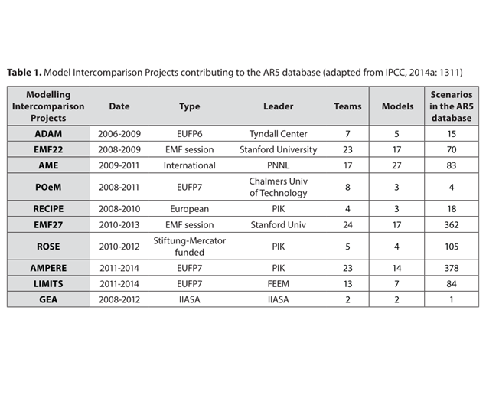
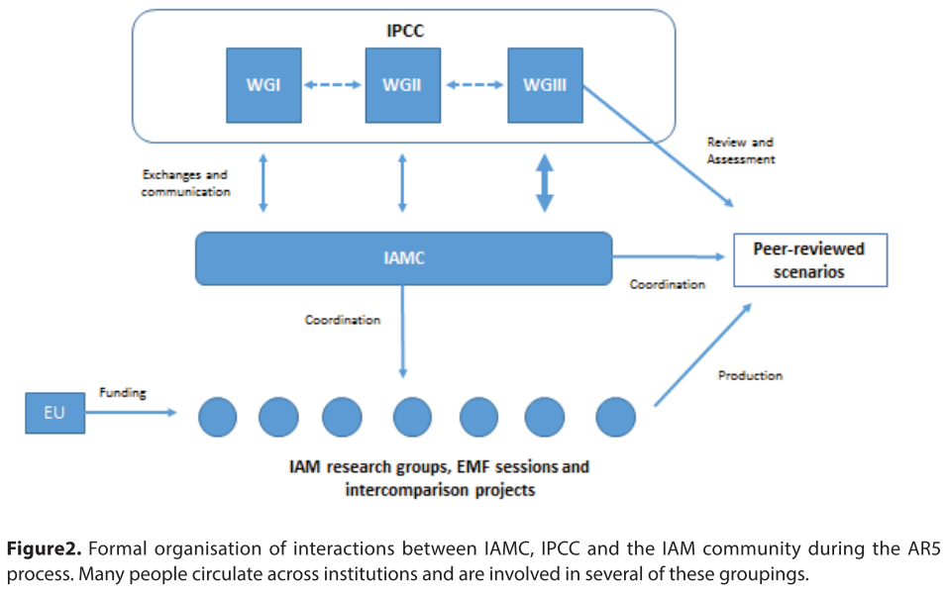
Socio-economic Scenarios
Socio-economic scenarios are exclusively produced using Integrated Assessment Models (IAMs)
IAMs are large-scale, complex numerical models that represent interactions among environmental, technological and human systems
MESSAGE, IMAGE, MARIA, AIM, MiniCam and ASF were selected to develop SRES reference scenarios
IAMC created in 2007 together with a consortium agreement with the IPCC
Variety and convergence among IAMs
Notes:
Cointe, B., Cassen, C., & Nadaï, A. (2019). Organising Policy-Relevant Knowledge for Climate Action. Science & Technology Studies, 32(4), 36–57. https://doi.org/10.23987/sts.65031

Slide 3
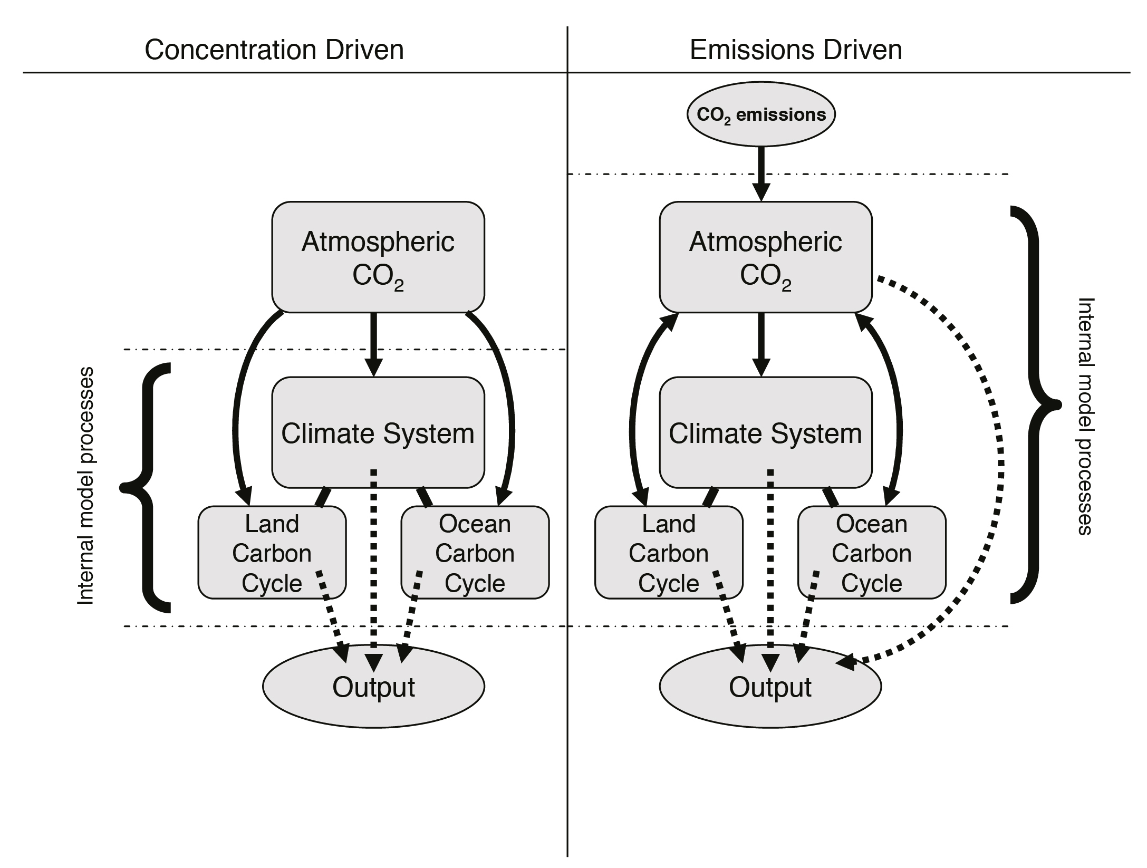
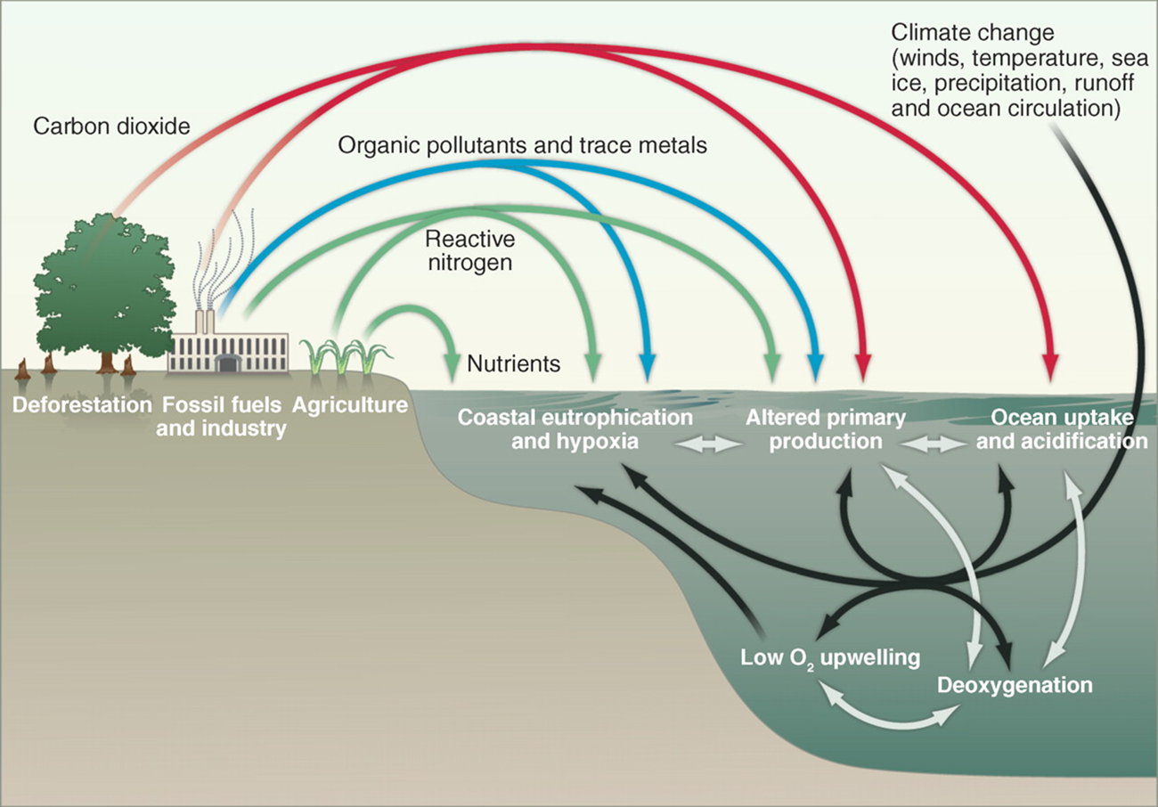
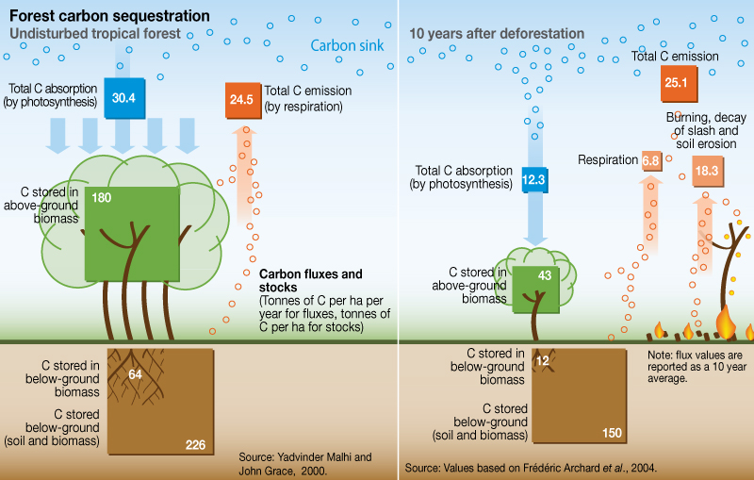
Biogeochemical Cycle
Notes:
IPCC, 2013: Climate Change 2013: The Physical Science Basis. Contribution of Working Group I to the Fifth Assessment Report of the Intergovernmental Panel on Climate Change [Stocker, T.F., D. Qin, G.-K. Plattner, M. Tignor, S.K. Allen, J. Boschung, A. Nauels, Y. Xia, V. Bex and P.M. Midgley (eds.)]. Cambridge University Press, Cambridge, United Kingdom and New York, NY, USA, 1535 pp.
Achard, F., Eva, H. D., Mayaux, P., Stibig, H.-J., & Belward, A. (2004). Improved estimates of net carbon emissions from land cover change in the tropics for the 1990s. Global Biogeochemical Cycles, 18(2). https://doi.org/10.1029/2003GB002142

Slide 4
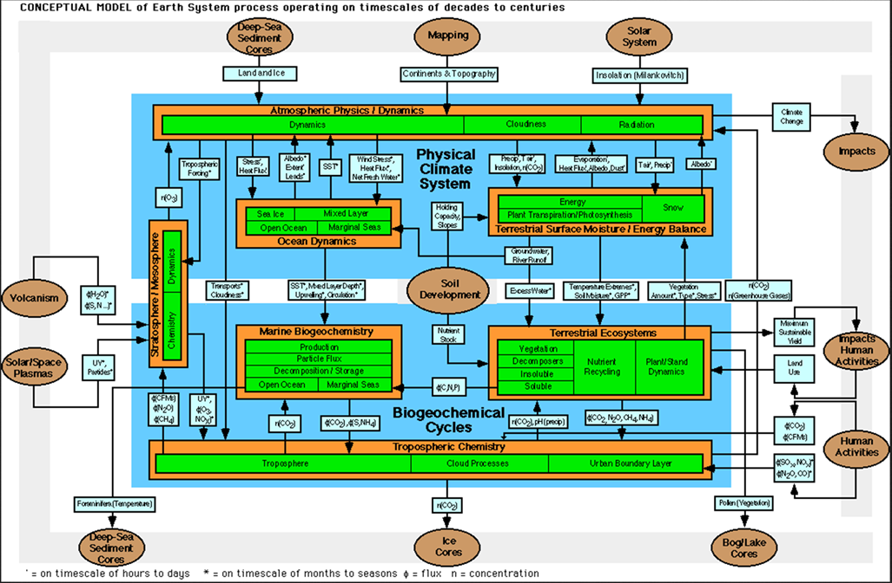
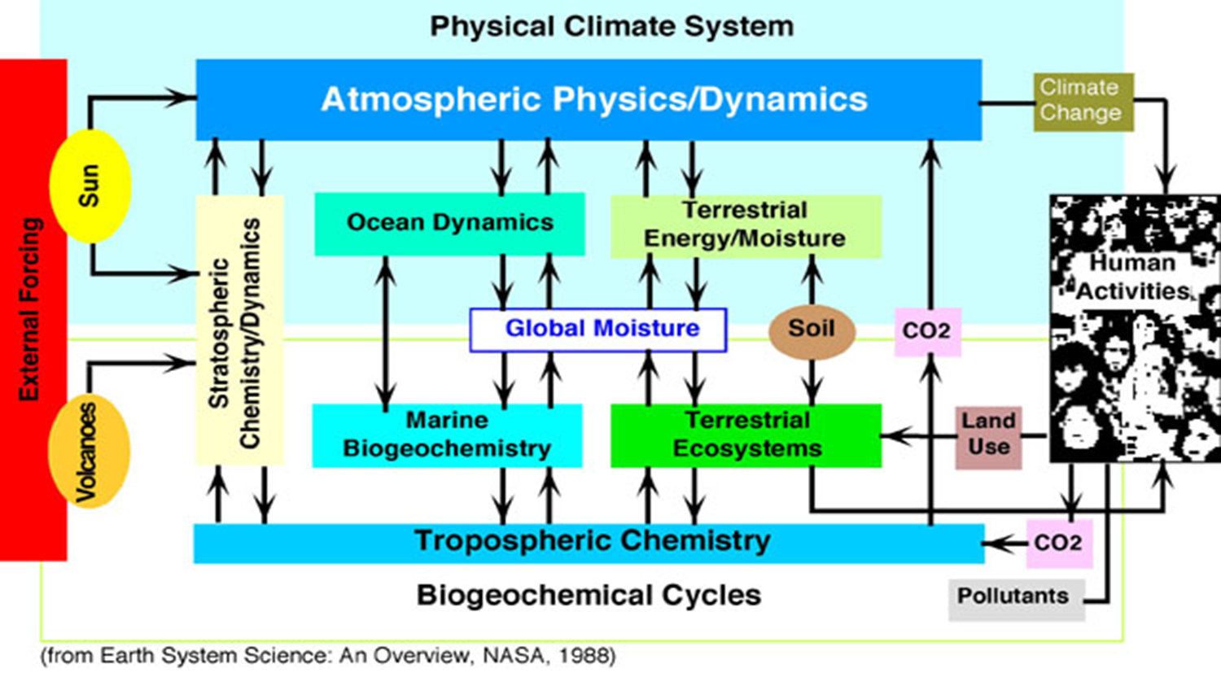
Earth System Interactions
Notes:
http://serc.carleton.edu/introgeo/earthsystem/index.html

Slide 5
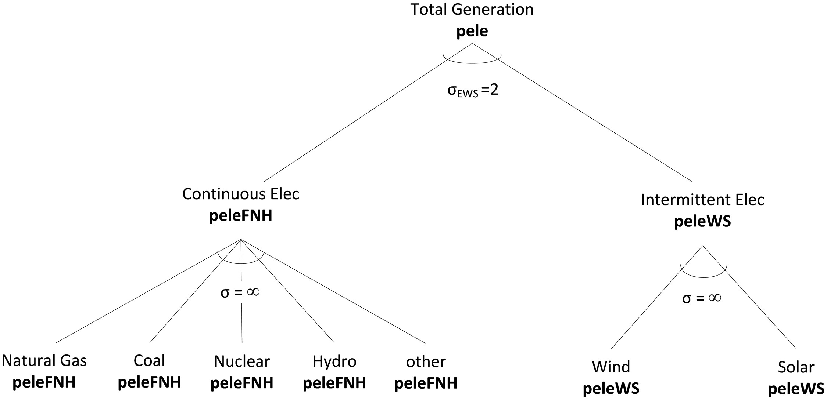
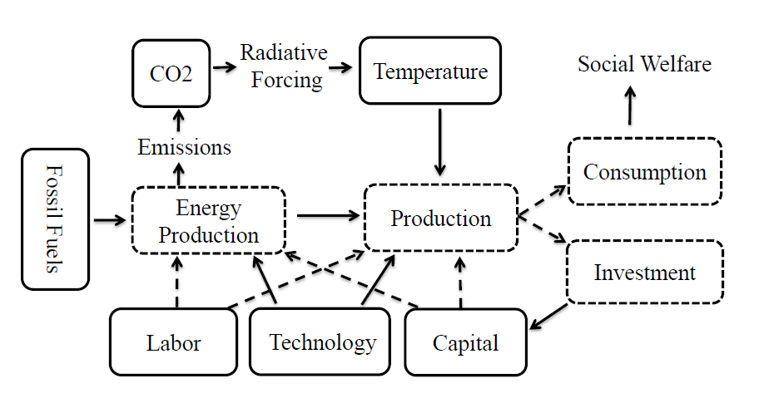
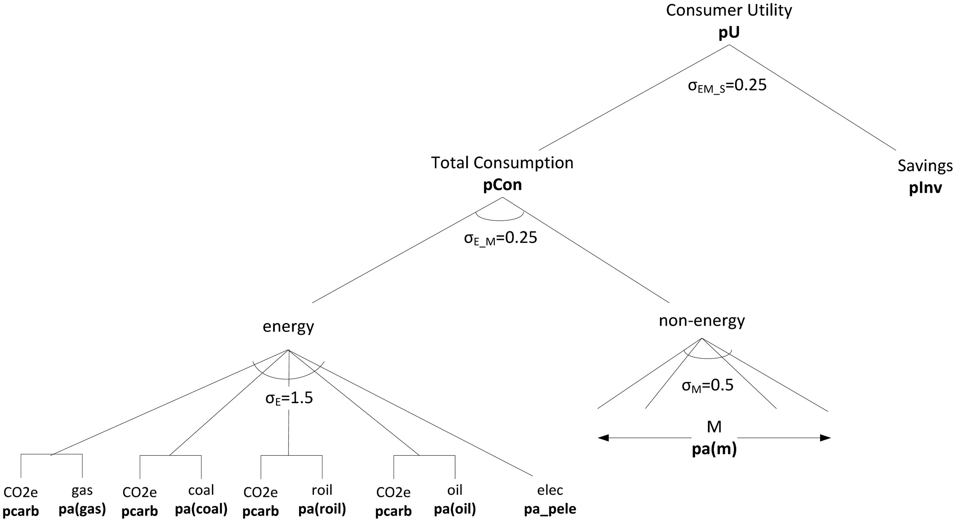
Integrated Assessment Modeling
Policies are chosen to maximize the social welfare function with utility and labor inputs
Economic well being of future generations are discounted
Temperature increase is used as input for damages to production
Radiative forcing is used as input for temperature increase
Carbon emissions impose social cost to the economy
Notes:
https://williamnordhaus.com/dicerice-models
Traeger, C. P. (2021). ACE – Analytic Climate Economy. SSRN Electronic Journal, October. https://doi.org/10.2139/ssrn.3832722
Kat, B., Paltsev, S., & Yuan, M. (2018). Turkish energy sector development and the Paris Agreement goals: A CGE model assessment. Energy Policy, 122(July), 84–96. https://doi.org/10.1016/j.enpol.2018.07.030

Slide 6
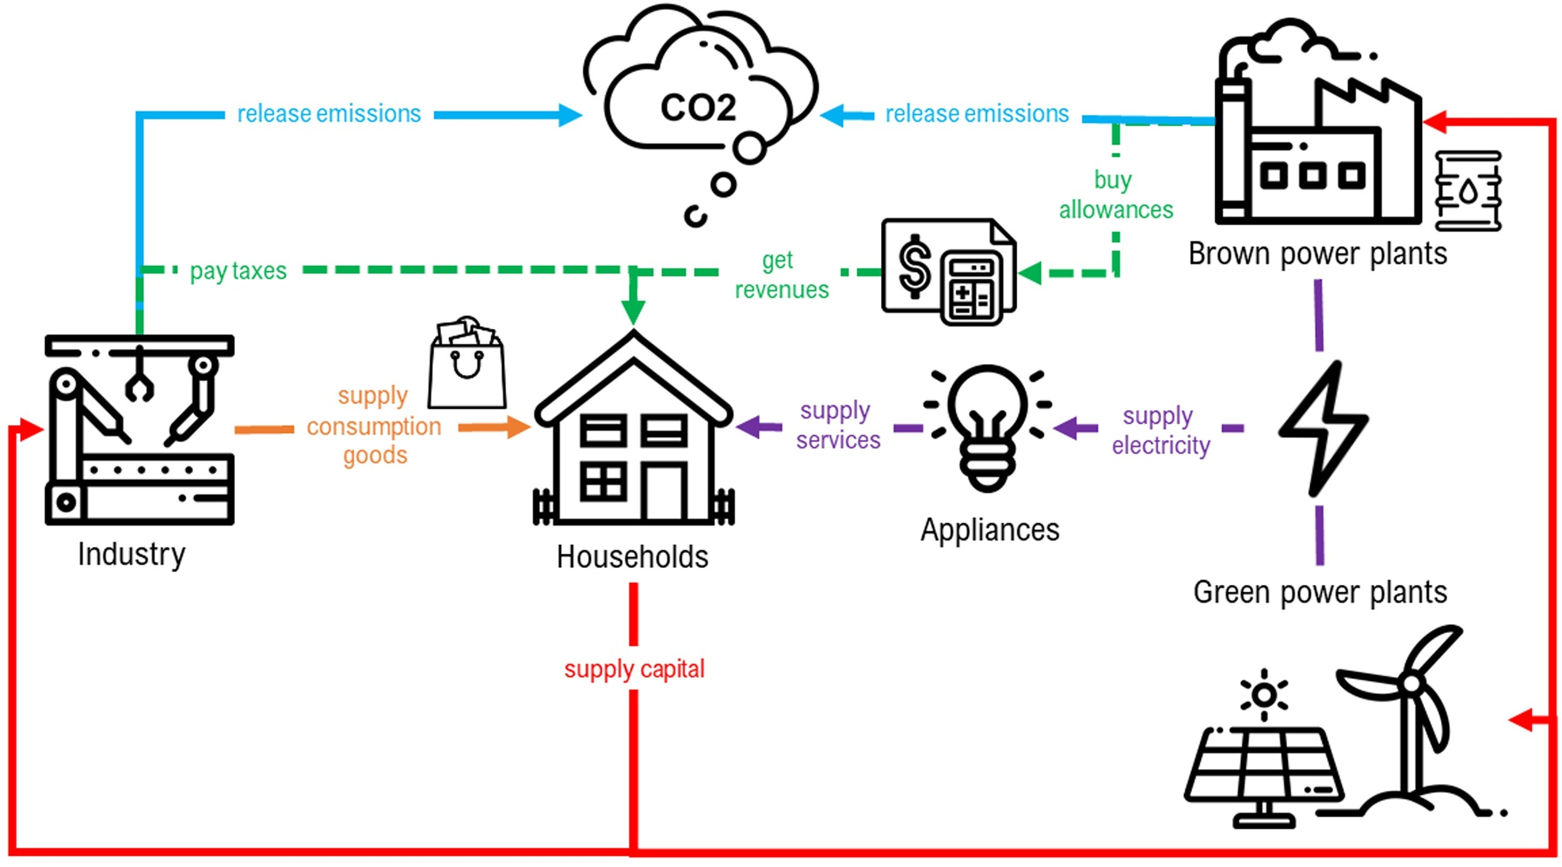
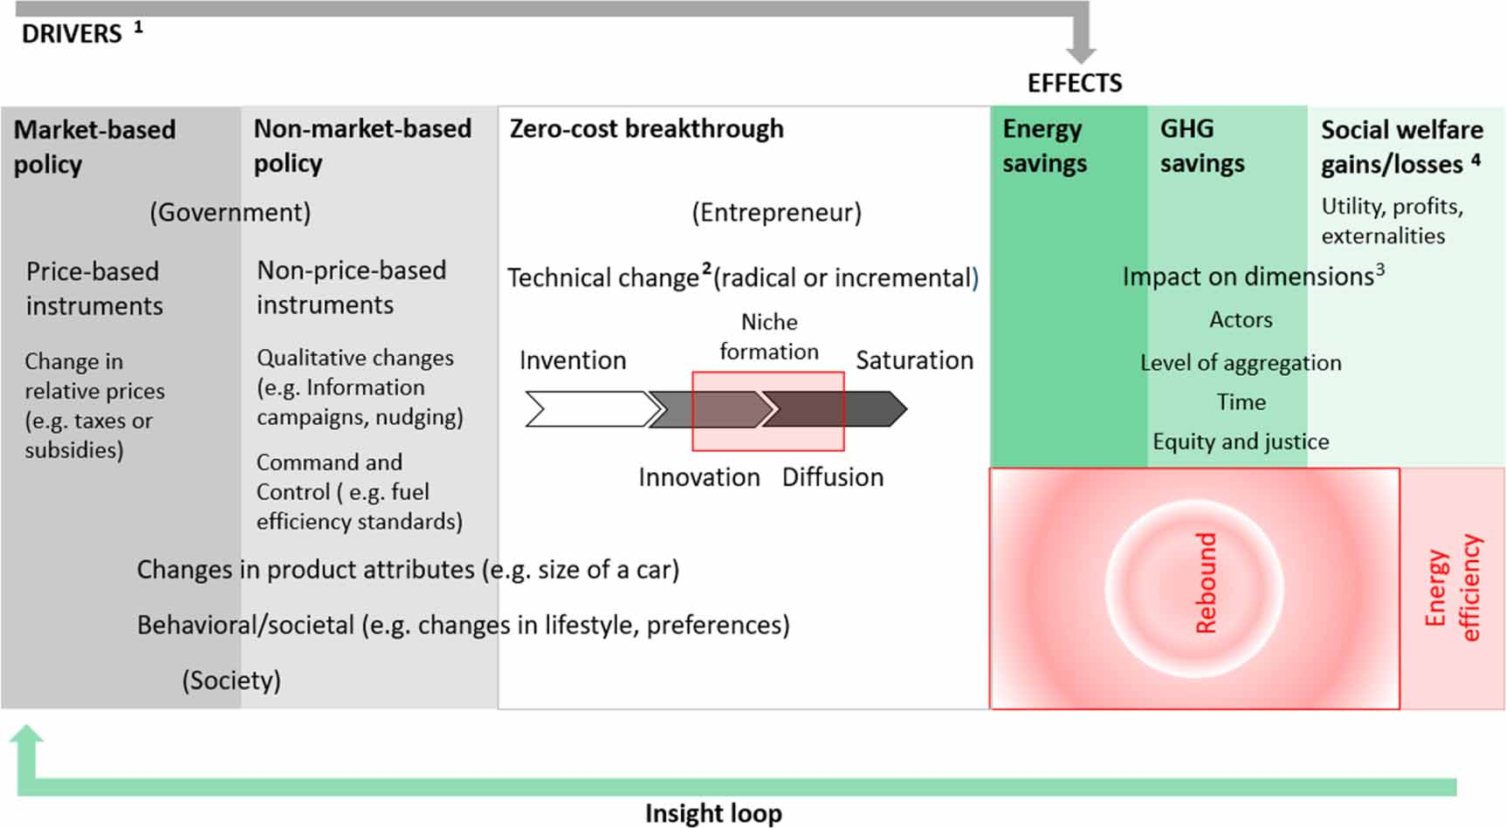
Rebound Effect
Energy efficiency (EE) and electrification investments may increase the final electricity demand Price based instruments (taxes, caps) effect the welfare of consumers
Product specifications are considered as a bundle (performance vs. efficiency)
Social behaviour may prevent EE investments (public transport vs. private car)
Save energy vs. reduce carbon emission
Notes:
Colmenares, G., Löschel, A., & Madlener, R. (2020). The rebound effect representation in climate and energy models. Environmental Research Letters, 15(12), 123010. https://doi.org/10.1088/1748-9326/abc214
Jarke-Neuert, J., & Perino, G. (2020). Energy efficiency promotion backfires under cap-and-trade. Resource and Energy Economics, 62, 101189. https://doi.org/10.1016/j.reseneeco.2020.101189

Slide 7
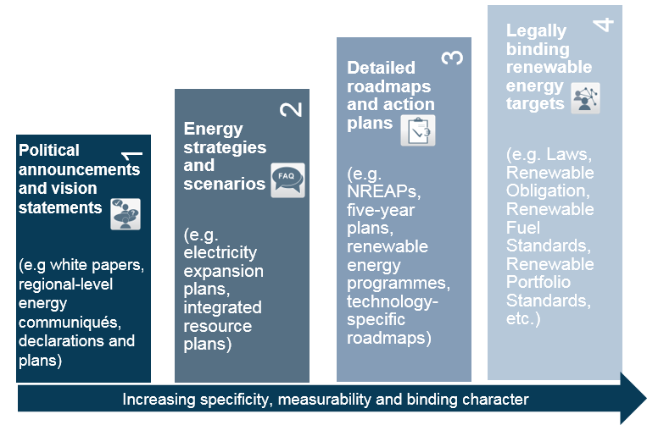
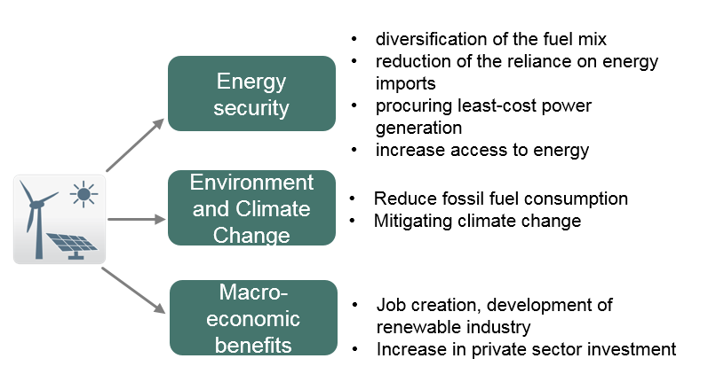
Social and Environmental Development
Increasing energy security and job creation with clean energy
Procuring the least cost power generation
Diversifying the fuel mix to increase security of supply
Reducing fossil-fuel consumption
Improving energy access
Mitigating climate change and other environmental risks
Increasing private sector investment in the renewables sector
Notes:
https://renewables-online.de/

Slide 8
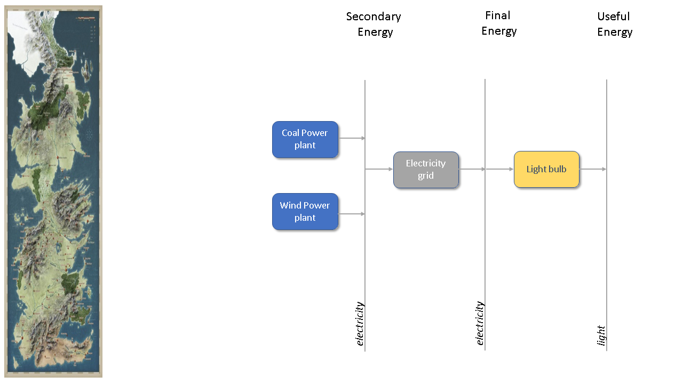
Baseline Energy System - Westeros
Notes:
This example is based on the Westeros Tutorial - Introduction to the MESSAGEix framework: Creating a baseline scenario.

Slide 9

Model Structure
The model horizon spans three decades (690-720)
Far in the future after the events of A Song of Ice and Fire (which occur ~300 years after Aegon the conqueror)
The discount ratio is 5% per year
Notes:
https://awoiaf.westeros.org/index.php/Aegon%27s_Conquest

Slide 10
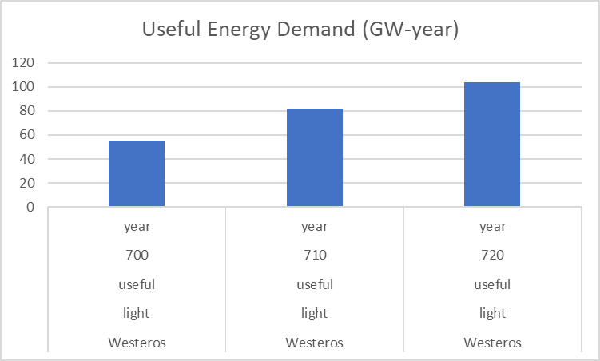
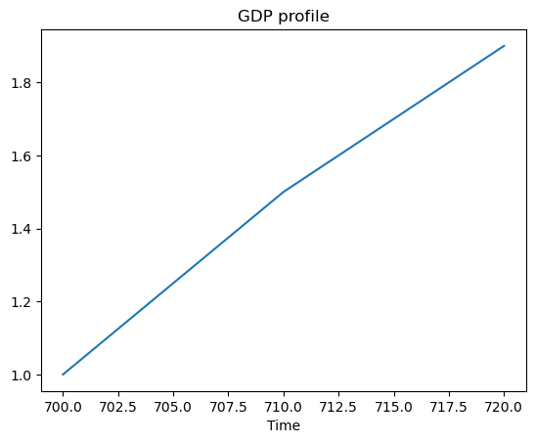
Energy Demand
Demand for electricity is correlated with production
GDP profile is similar to first world historical profiles in the beginning of the 20th century
Model assumptions:
40 million people in 300 AC
Similar population growth to Earth in the same time frame (~factor of 12)
A per capita demand for electricity of 1000 kWh

Slide 11
Technology Parameters
Activity costs | USD / kWyr
Electricity grid | 50
Coal power plant | 30
Technology | Main input | Main output | Efficiency
Light bulb | Elec./Final | Light/Useful | 1
Grid | Elec./Secon. | Elec./Final | 0.9
Coal_ppl |  | Elec./Secon
Wind_ppl |  | Elec./Secon
Investment costs | USD / kW
Light bulb | 5
Coal power plant | 500
Wind power plant | 1500
Historical capacity addition | MW/year
Light bulb | 12224 (690-699)
Coal power plant | 2685 (680-699)
Wind power plant | 4755 (680-699)
Fixed costs | USD / kW/yr
Coal power plant | 30
Wind power plant | 10
Operating lifetime | Years
Light bulb | 10
Coal power plant | 20
Wind power plant | 20
Capacity factor | Share
Wind power plant | 0.36

Slide 12
Historical Capacity
Electricity generation from coal and wind power plants
New capacity needs to be created to replace the retiring capacity and meet increasing demand
New capacity is created only when the investment cost is defined
Reference year capacity | MW
Light bulb | 55008
Coal_ppl | 38932.5
Wind_ppl | 68947.5

Slide 13
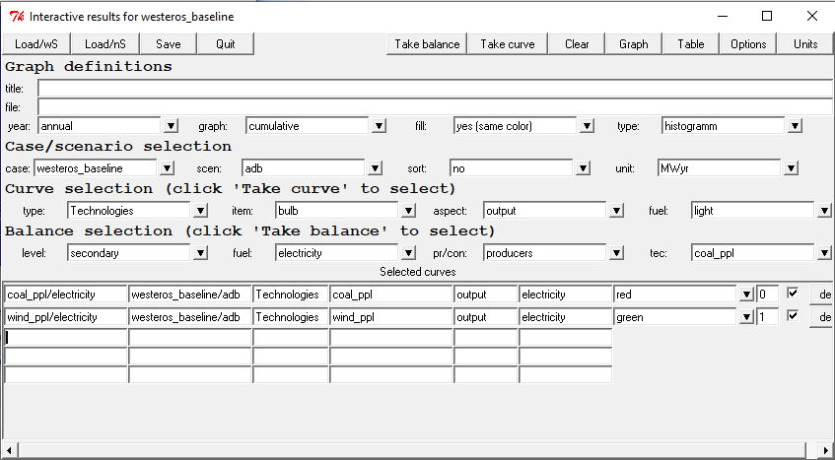
Running the Problem
Select the «adb» scenario from «Select -> scenario
Generate the lineer programming matrix from «Run -> mxg»
Run the optimization solver from «Run -> opt»
Select the «Results -> interactive» screen to see the results in tables and graphs
Rows | 49 | Equations
Cols | 16 | Variables
Elms | 116 | Parameters
Rhs | 21 | Right hand side constraints
Bnds | 2 | Constant bounds

Slide 14
Baseline Scenario
Secondary Electricity
Total installed capacity
Notes:
Problem: westeros_baseline_adb
Rows: 49
Columns: 16
Non-zeros: 116
Status: OPTIMAL
Objective: func = 90595161.57 (MINimum)

Slide 15
Introducing Emissions
Coal power plants emit CO2 causing air pollution and stimulating climate change
Copy "westeros_baseline" to "westeros_emission" to develop a new scenario
Define coal resources and primary energy sources as the model uses the technology input for emission calculation
Define CO2 emissions as a cumulative constraint
Include the CO2 emission factor to coal power plant technology
Emission factor | Factor
Coal power plant | 7.4 tCO2/kWyr
Emission bound | Cap
CO2 emissions | 8000 MtCO2 or 400 MtCO2/yr

Slide 16
Emissions Cumulative Bound Scenario
Secondary Electricity
Total installed capacity
Notes:
Problem: westeros_emission_adb
Rows: 55
Columns: 20
Non-zeros: 128
Status: OPTIMAL
Objective: func = 119,422,348.2 (MINimum)

Slide 17
Emissions Cumulative Bound Scenario
Electricity price
CO2 emission

Slide 18
Emissions Annual Bound Scenario
Secondary Electricity
Total installed capacity
Notes:
Problem: westeros_yearly_adb
Rows: 56
Columns: 20
Non-zeros: 128
Status: OPTIMAL
Objective: func = 133,553,382.9 (MINimum)

Slide 19
Emissions Annual Bound Scenario
Electricity price
CO2 emission

Slide 20
External Costs
Coal power plant utilities can benefit from generating additional electricity
The benefit from creating additional electricity from coal power plants causes additional CO2 emission
Annual constraint creates a shadow price defined as the benefit gained from additional electricity generation per additional CO2 emission
The price is what the coal power plant utilities are willing to pay – therefore negative

Slide 21
Emissions Tax Scenario
Secondary Electricity
Total installed capacity
Notes:
Problem: westeros_tax_adb
Rows: 56
Columns: 20
Non-zeros: 129
Status: OPTIMAL
Objective: func = 212,650,767.7 (MINimum)

Slide 22
Emissions Tax Scenario
Electricity price
CO2 emission

Slide 23
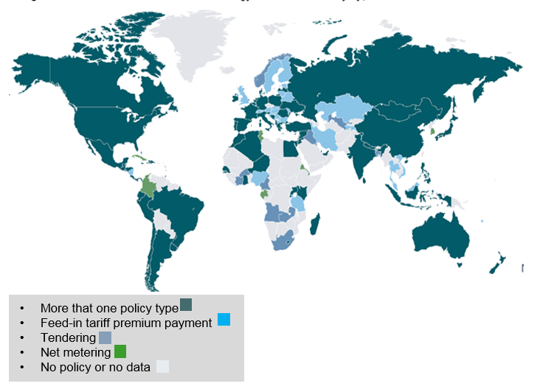

Discussion
Emission bound generates a shadow price for additional CO2 emission which can be traded between utilities
The revenues collected by emission tax can be used for subsidizing clean energy generation through feed-in-tariffs
The achievement of the climate target requires using a basket of policy instruments from energy supply and demand sectors
Notes:
Description
This image includes recognisable people, being impacted locally. Research suggests making this link as tangibly as possible is crucial for engaging audiences and situating climate change in the ‘here and now’.
© Ashley Cooper / Aurora Photos

Slide 24
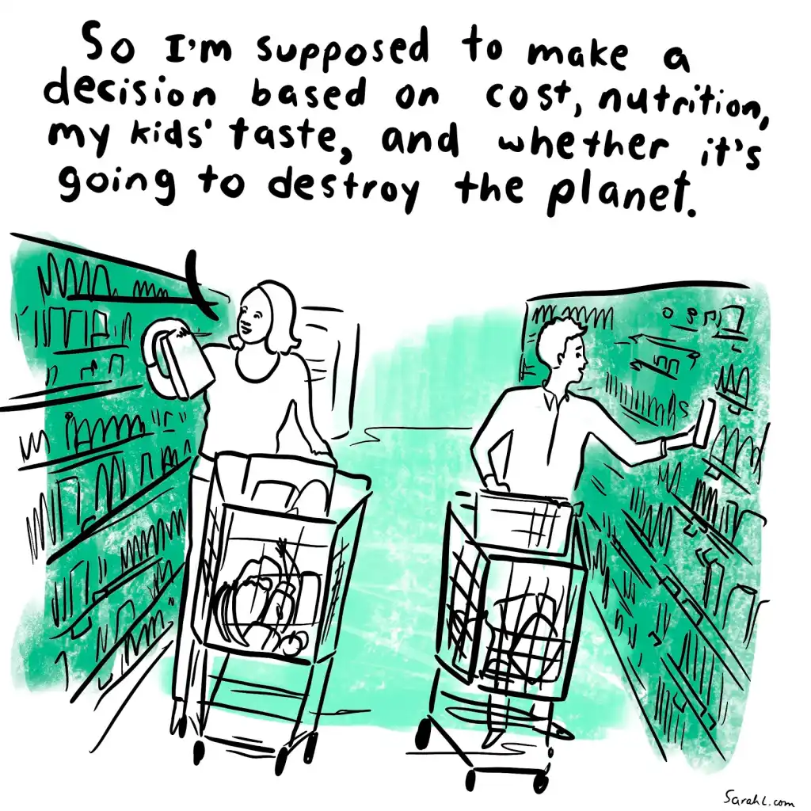

Recommendations
Learn GAMS together with student license from https://www.ifpri.org/publication/agrodep-gams-training-toolbox
Follow the announcements and the recent developments from https://www.iamconsortium.org/newsletter-subscription/
Try to master at least one programming language
Reach out to others and share your ideas – remember that climate action requires collaborative effort
Notes:
Description
Research has found that telling ‘local’ visual stories is an important component for effective engagement – showing real people, in a range of regional contexts, being affected by and responding to climate change.
© Peter Essick / Aurora
https://www.yesmagazine.org/opinion/2020/10/23/climate-literacy-effective-change

Slide 25
References
[1] Cointe B, Cassen C, Nadaï A. Organising Policy-Relevant Knowledge for Climate Action. Sci Technol Stud [Internet]. 2019. 32(4):36–57.
[2] Traeger CP. ACE – Analytic Climate Economy. SSRN Electron J [Internet]. 2021. (October).
[3] Kat B, Paltsev S, Yuan M. Turkish energy sector development and the Paris Agreement goals: A CGE model assessment. Energy Policy [Internet]. 2018. 122(July):84–96.
[4] Colmenares G, Löschel A, Madlener R. The rebound effect representation in climate and energy models. Environ Res Lett [Internet]. 2020. 15(12):123010.
[5] Jarke-Neuert J, Perino G. Energy efficiency promotion backfires under cap-and-trade. Resour Energy Econ [Internet]. 2020. 62:101189.

